Slide 1
Getting Started with Jenkins
COURSE OVERVIEW

Slide 2
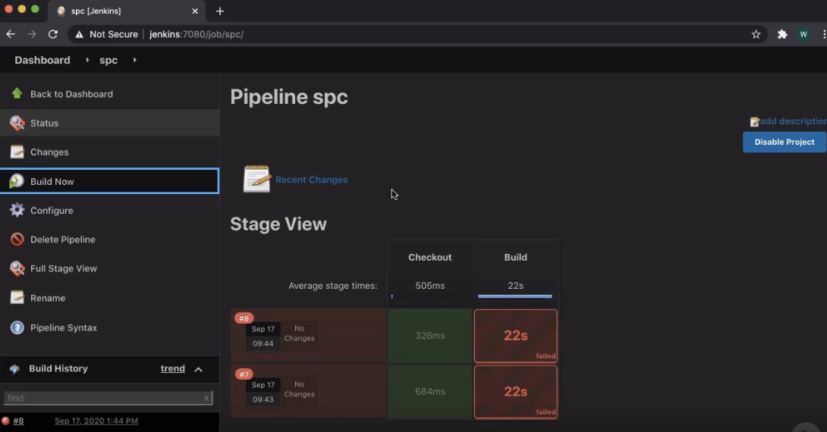

Slide 3
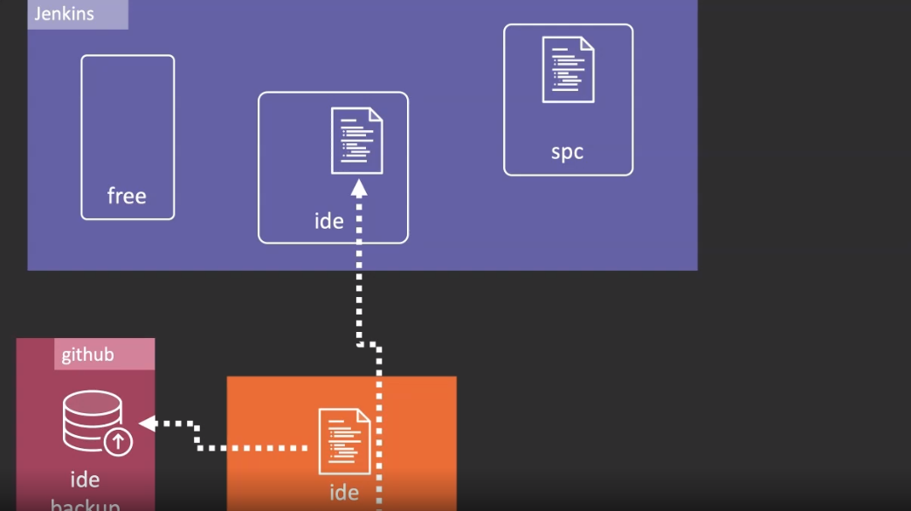

Slide 4
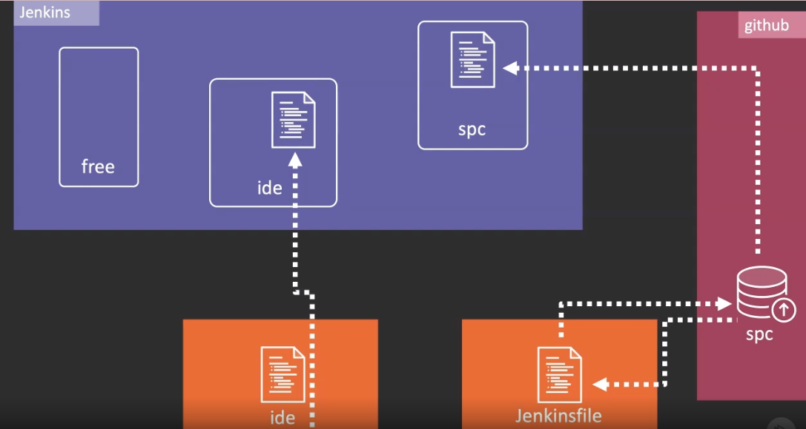

Slide 5
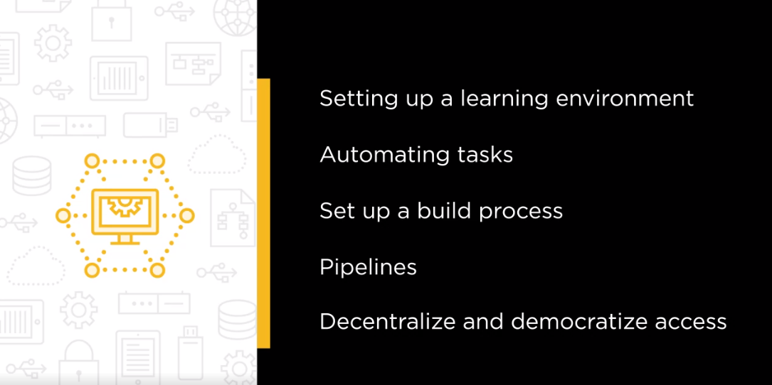

Slide 6
